Slide 1
LECTURE-11 PIGEONHOLE PRINCIPLE (with proof)
The pigeonhole principle is a simple, yet beautiful and useful idea. Given a set A of pigeons and a set B of pigeonholes, if all the pigeons fly into a pigeonhole and there are more pigeons than holes, then one of the pigeonholes has to contain more than one pigeon.
The pigeonhole principle states that if n items are put into m containers, with n > m, then at least one container must contain more than one item.
Definition :
Formally, think of the pigeonhole principle as the statement about a function f from domain P → PH, where pigeon n flies into pigeonhole f(n), as is shown below:

Slide 2
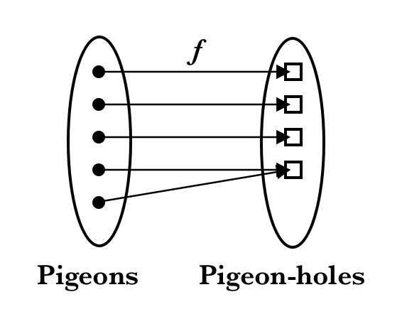
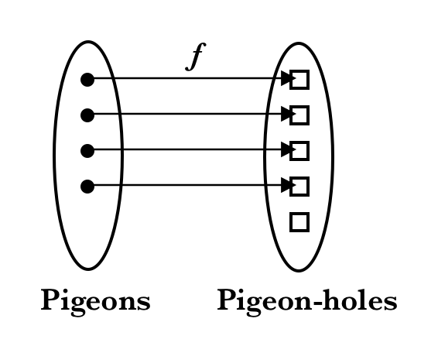
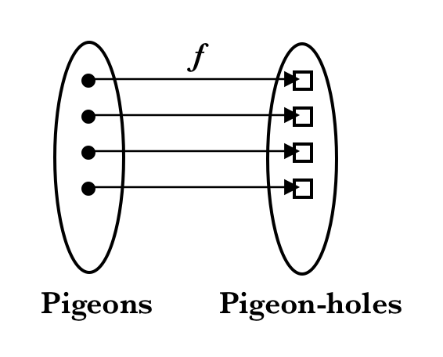
Figure 1. A: More pigeons than pigeonholes |n| > |f(n)|. B: Same number of pigeons as pigeonholes |n| = |f(n)|. C: More pigeonholes than pigeons |n| < |f(n)|

Slide 3
The three cases illustrate three types of functions from a domain (“pigeons”) to a codomain “pigeonholes” which can be mapped to one another:
Case A: If |n| > |f(n)|, then the function is a non-injective surjective function (not a bijection)
Case B: If |n|= |f(n)|, then the function is a injective surjective function (bijection)
Case C: If |n| < |f(n)|, then the function is an injective non-surjective function (not a bijection).
Case A is the case illustrating the essence of the pigeonhole principle, namely that if you put n items into m containers and n > m, then at least one container must contain more than one item. The function f that maps pigeons into pigeonholes is hence called a surjective function.

Slide 4
We may prove the principle easily by contradiction:
Proof of Pigeonhole Principle :
Suppose that the total number of pigeons n are to be put in m number of pigeonholes and n > m. Assume that there are no pigeonholes with at least n/m pigeons, i.e. that each pigeonhole has less than n/m pigeons:
Number of pigeons in each pigeonhole < n/m
Number of pigeons < m × n/m
Number of pigeons < n
But given that the number of pigeons is strictly equal to n, we have obtained a contradiction to our assumption that each pigeonhole has less than n/m pigeons. Hence there exists at least one pigeonhole with at least n/m pigeons.

Slide 5
GENERALIZED PIGEONHOLE PRINCIPLE :

Slide 6

QUESTIONS
1. Danny has a bunch of dice in his drawer. He recalls that 5 of them are green, 6 of them are blue and 7 of them are red. He reaches in and grabs several without looking. How many does he have to grab, in order to ensure that 3 of them are the same Color?
SOL. We apply the Pigeonhole Principle. The pigeons are the dice that he grabs, and the holes are the colors of the dice. There are 3 holes, corresponding to red, blue, green.
Thus, when she grabs 7 dice, the pigeonhole principle tells us that there will be at least

